Slide 1

Zomato Data Analysis Project
Using Excel, Power BI, Tableau & SQL
By Gayatri Gorde
This project delivers deep insights from Zomato's restaurant and user data. It leverages Excel, Power BI, Tableau, and SQL to drive strategic growth opportunities.

Slide 2
Data Sources and Methodology
Data Collection
Data Cleaning
Sample Dataset
Web scraping
Handling missing values
9551 restaurants across 15 countries and 141 cities
Zomato API access
Removing duplicates
User survey data
Resolving inconsistencies

Slide 3
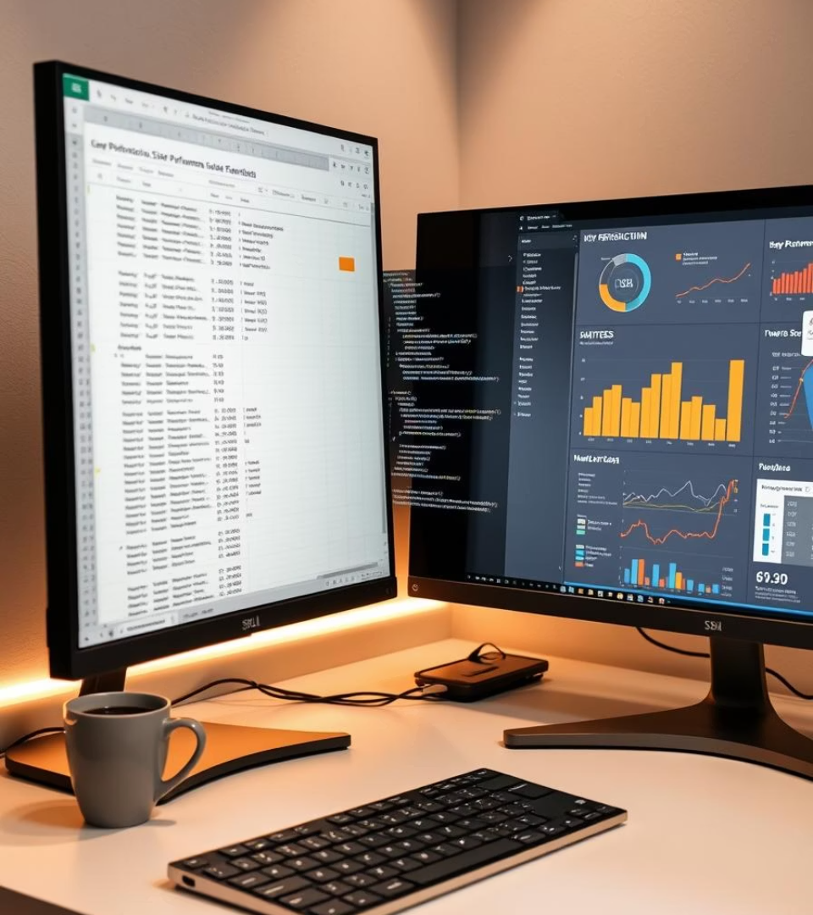




Tools and Technologies
Excel
Power BI
Data exploration and cleaning
Interactive KPI dashboards
Tableau
SQL
Advanced visual analytics
ETL processes using PostgreSQL

Slide 4
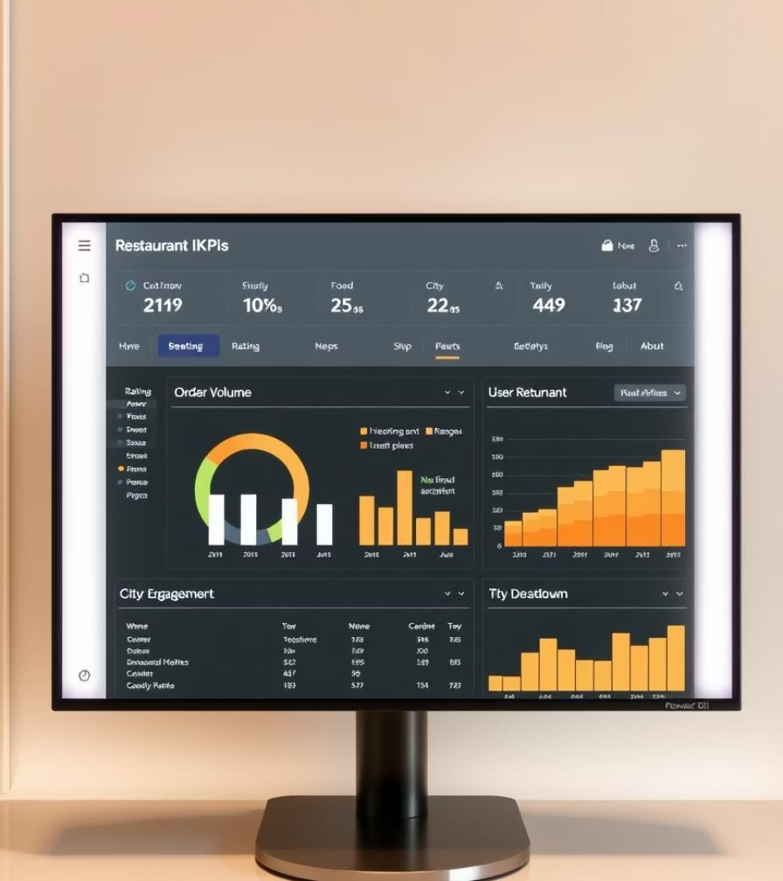
Dashboard Overview: Key Metrics
Total Restaurants
Listings by city with detailed counts
Average Rating
Overall user satisfaction scores
Order Volume
Daily and monthly order trends
User Engagement
Active users, review frequency, interactions

Slide 5
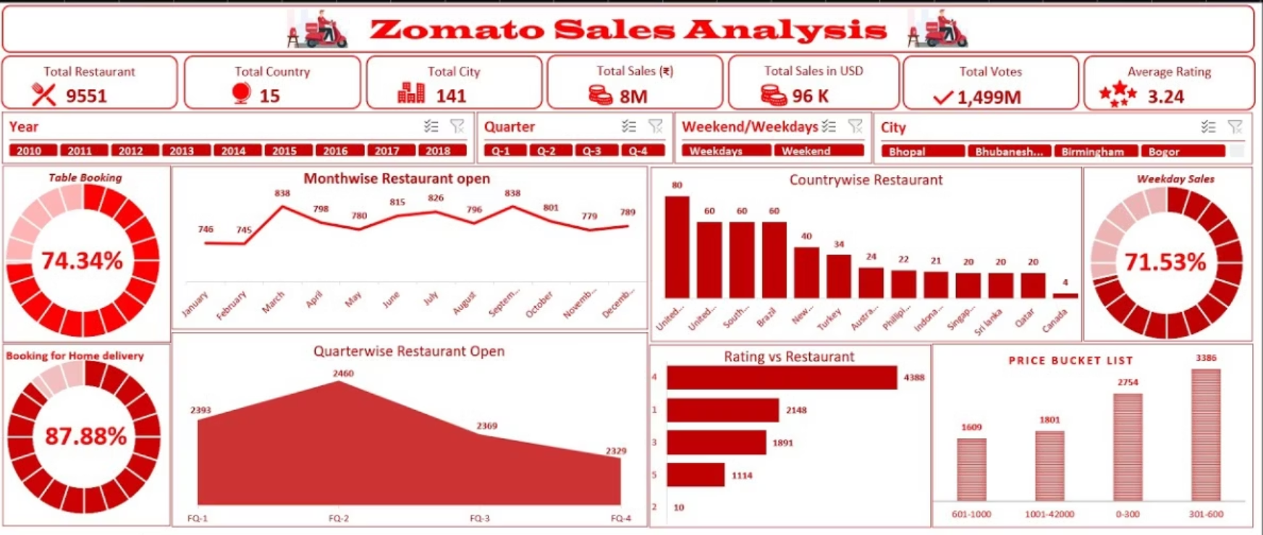
Excel Visualizations:
The Excel dashboard provides a simplified view of Zomato data, focusing on essential metrics like restaurant count, rating distribution, and service availability. It uses pivot tables and charts to highlight trends in cuisines, delivery options, and table booking status for quick insights.

Slide 6
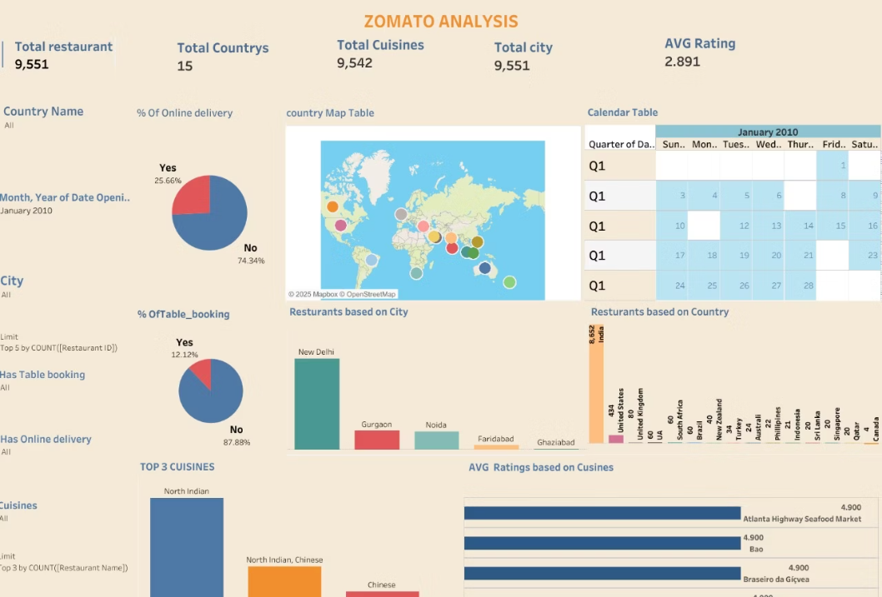
Tableau Visualizations:
Interactive dashboards created using Tableau to visualize key Zomato metrics such as restaurant distribution by country, popular cuisines, ratings, and delivery options. Filters and drill-downs enable dynamic data exploration and deeper insights.

Slide 7
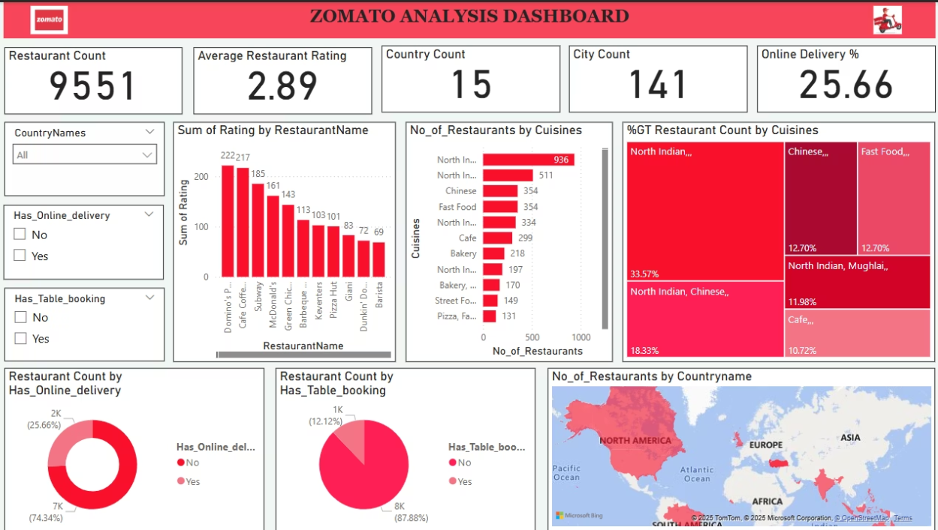
Power BI Visualizations:
The Power BI dashboard presents key insights into Zomato’s data, including total restaurants, average ratings, top cuisines, and delivery options. It uses bar charts, KPIs, and a world map to show restaurant trends across countries, with interactive filters for easy exploration.

Slide 8
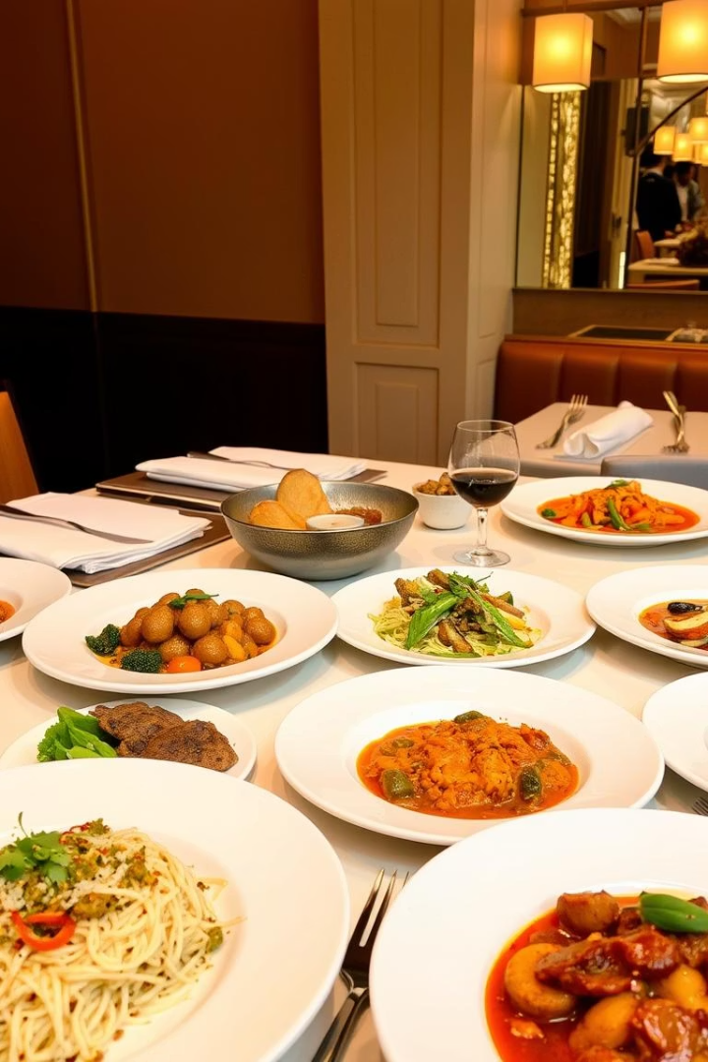
Key Insight: Cuisine Preferences
1
Online Delivery vs Table Booking
2
Delivery Trends
Only 26% of restaurants offer online delivery, indicating limited digital reach
Analyzing how customers prefer to access restaurant services
3
Table Booking Insights
Around 28% of restaurants support table booking, showing it's still a niche offering

Slide 9
Key Insight: Pricing and Affordability
Price and Ratings
Analyzing pricing trends and affordability reveals how price fluctuations impact customer purchasing behavior. The dashboard shows that certain price tiers are more accessible to the target audience, highlighting potential areas to adjust pricing for better market competitiveness and customer satisfaction.

Slide 10

Areas for Improvement: Customer Experience
Search and Recommendations
Enhance algorithms for better personalization
User Personalization
Tailor based on preferences and past behavior
Delivery Time
25% users dissatisfied, need faster service
Customer Support
Improve responsiveness, aim to reduce tickets by 10%

Slide 11

Strategic Recommendations for Zomato
Enhance Customer Support
Strengthen customer support channels
Diversify Cuisine
Match offerings to local demand
Dynamic Pricing
Optimize revenue and satisfaction
Technology Integration
Improve delivery times, reduce churn

Slide 12

Conclusion
Actionable Insights
Market Expansion
Drive Zomato's growth with data-backed strategies
Focus on expanding to underserved tier-2 cities and diversifying offerings to cater to regional preferences.
Customer Satisfaction
Enhance customer experience through personalized services, faster delivery, and improved support.

